Slide 1
Mini-Project Progress Review 2
Project Title : Network Traffic Analyzer and Visualizer
Project Guide : Dr Sivaraman E
Project Team ( Names & USN) : Vaibhav Raj (PES1UG19CS554)
Divyansh Raina (PES1UG19CS149)
Ashwin K (PES1UG19CS095)

Slide 2
Project Abstract and Scope
Abstract:
It analyses the traffic coming to a server and collects information about the traffic and presents the data in a graphical manner.
Scope:
To Provide data to be used to provide edge computing solutions to ensure low latency, good network performance, high bandwidths for applications and services which are very critical and sophisticated.

Slide 3
Suggestions from Review - 1
Suggestion:
For generating traffic we were suggested to come up with something better than nping .
Progress:
We decided to create a simple python program which generates traffic using proxies so that the traffic seems to come from different locations.

Slide 4
Detailed Literature Survey
Day by day the network traffic coming to a server is increasing due to rise of pervasive computing and incoming 5G technology.
The current cloud computing scenario may not provide enough computing capacity to manage latency and performance requirements set by modern pervasive computing systems.
Scaling up an Edge Server Deployment – by Lauri Loven, Tero Lahderanta, Leena Ruha, Teenu Leppanen, Ella Peltonen
Wireshark For Security Professionals - Jessy Bullock

Slide 5
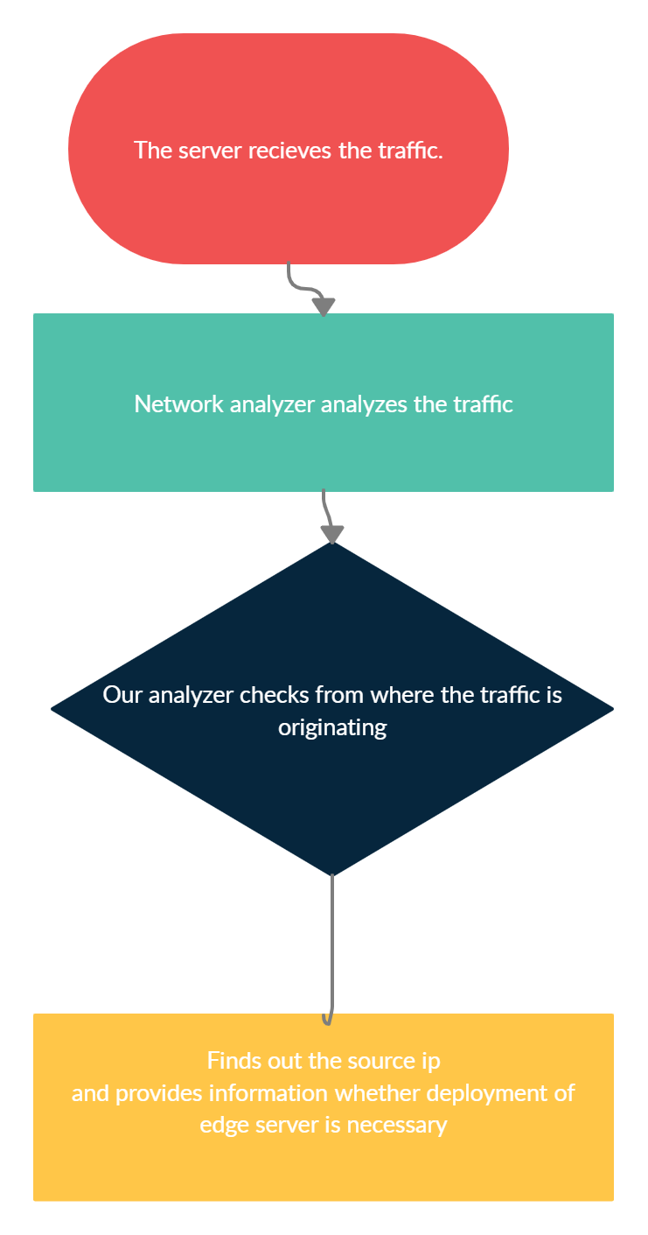
System Design

Slide 6
Technologies Used
Node.js : For Creating the server instance
Express/HTML : For designing the frontend
localtunnel npm module : To expose the server to internet
Python : Major Programming language used
free-proxy-list.net : For generating traffic which seems to originate from different locations
Packet-Sender : A free tool for generating traffic
Tshark : Packet sniffer used to capture network traffic
Wireshark : Wireshark was used during the development of the project.
Bash : Used to automate execution of some scripts
Scapy : Used to process the capture file & extract data
ip-api.com : API used to get geolocation from IPv4 address
Plotly : Python library used to make interactive graphs

Slide 7
Project Progress so far
All major work related to coding is completed.
The program is currently accepting requests from normal browsers and bots (using python requests module)
It analyses the HTTP traffic and extracts out the source IP
Using this data two graphs are made
A bar chart showing number of requests from each country
A globe map of traffic sources

Slide 8
A Case Study
Recently NEET result was out and like every year the server was down within minutes . The total number of candidates which appeared for NEET was more than 15 lakhs . But all of these students are not distributed equally in the country. The number of students in each state vary. So we could try to reduce the problem of servers crashing by analysing from which regions the traffic is more and using this data, edge servers could be set up in such regions.
Thank You

